Slide 1

Customer Purchase & Sales in Retail E-commerce

Slide 2
Overview of the Data

Slide 3
Total Customers
1445
Total Products
321
Total Orders
1615
Total Sales
7.96M
Total Discounts
497.57
Total Profits
1.68M

Slide 4
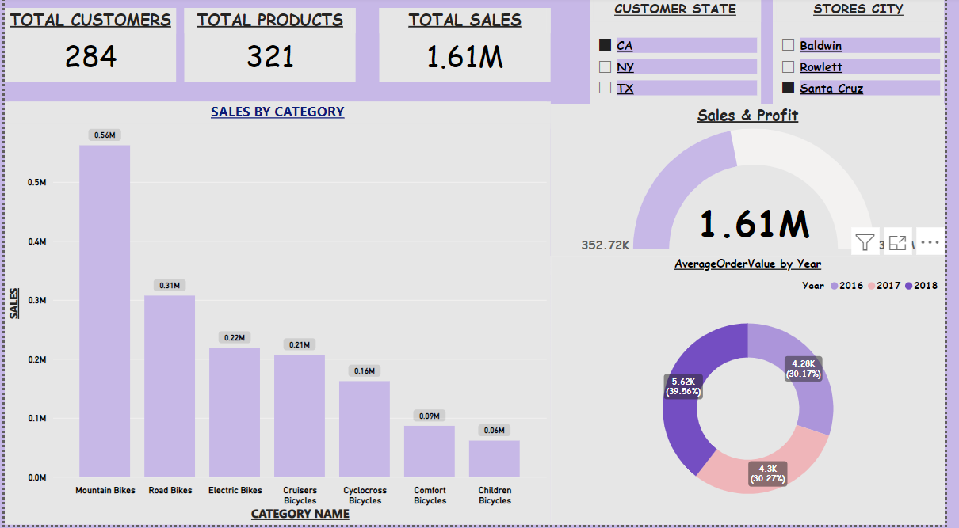
California Sales
*California customers did not purchase from Baldwin & Rowlett stores
*California customers did not purchase from Santa Cruz stores

Slide 5
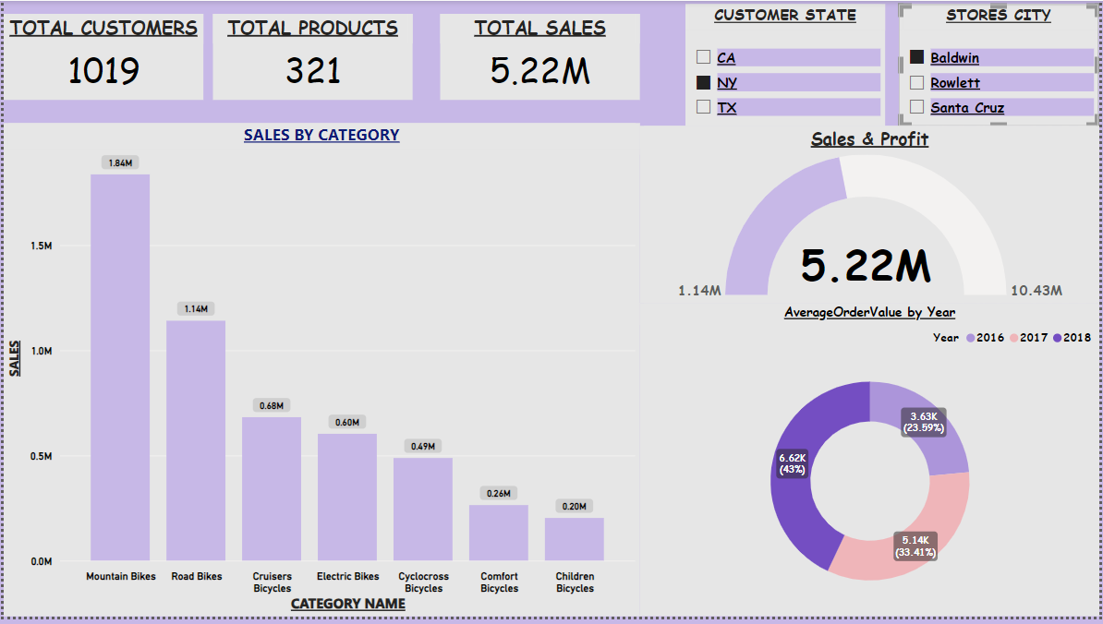
New York Sales
*NY customers did not purchase from Rowlett & Santa Cruz stores
*California customers did not purchase from Baldwin stores

Slide 6
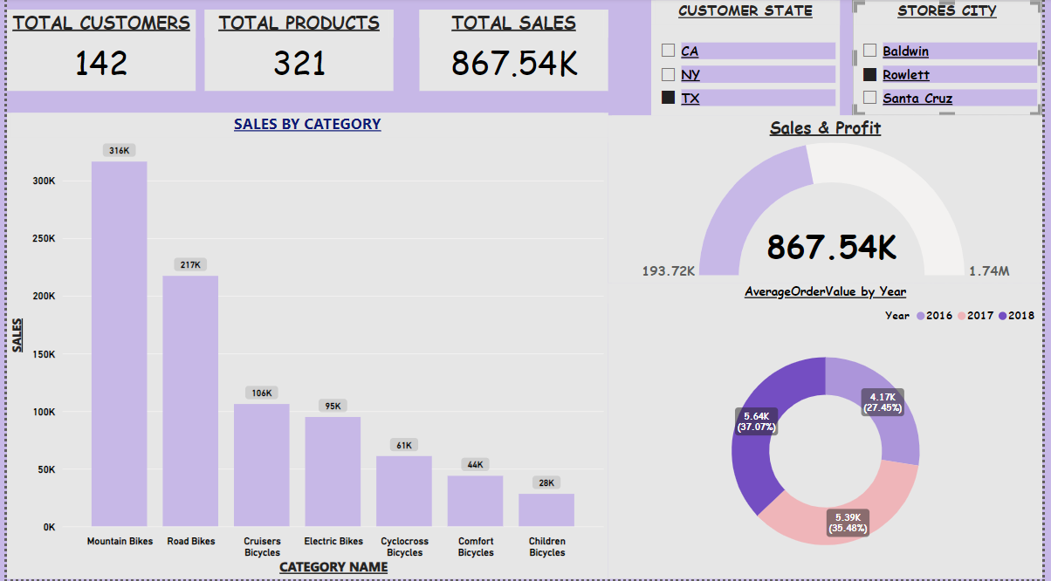
Texas Sales
*TX customers did not purchase from Baldwin & Santa Cruz stores
*California customers did not purchase from Rowlett stores

Slide 7


